Slide 1
1b.3
D-band SiGe Subharmonic Downconverter with Dynamic Conversion Gain and Fixed Input Compression
Jonathan Tao, James Buckwalter
University of California, Santa Barbara
UC Santa Barbara Santa Barbara, California 93106

Slide 2
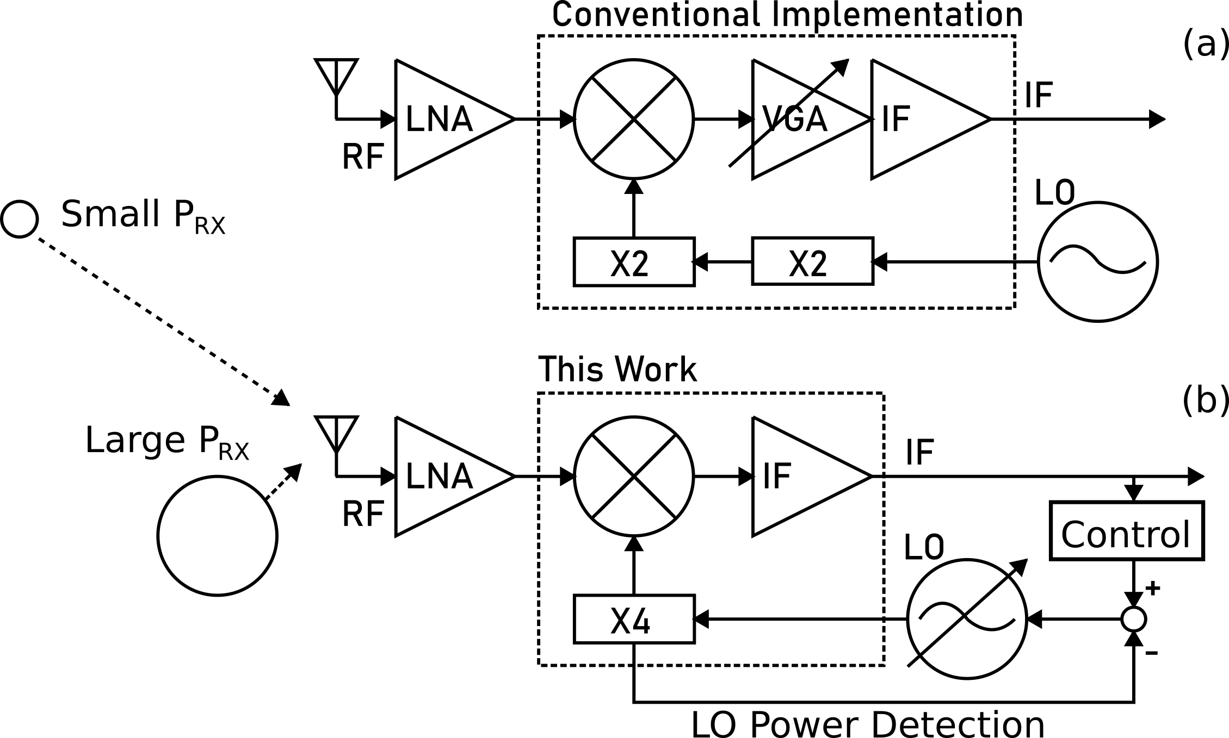
Motivation
Power consumption above 100 GHz is prohibitive:
mobile applications
Radar-radio fusion on platform
LO system power dominates receiver power consumption
Reduce power in LO chain dynamically with channel conditions

Slide 3
Goals of This Work
X4 Subharmonic downconverter at D-band (110 GHz – 170 GHz)
Linearize gain on LO frequency multiplier
backoff controllability to save power
Simplify circuit to save power and to integrate into an array

Slide 4
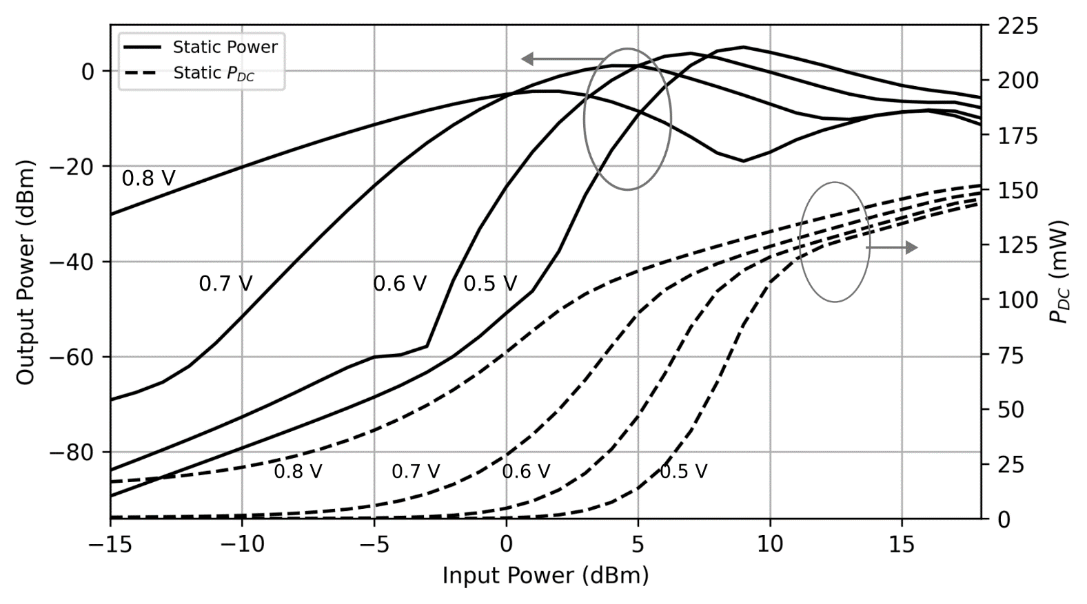
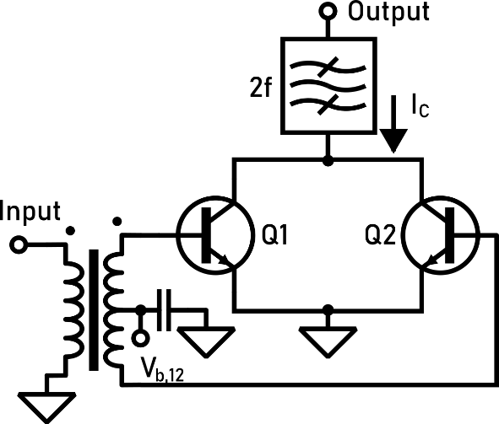
Problem: Gain Sensitivity
Typical multiplier chains operate at a single saturating power
High gain sensitivity in back-off power conditions: poor controllability
Simulation on frequency doubler with different biases for optimization

Slide 5
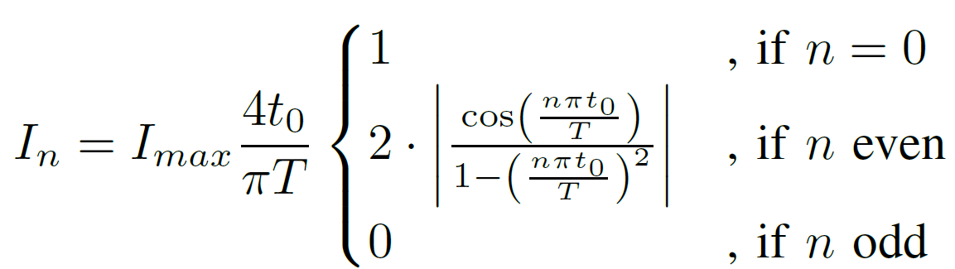
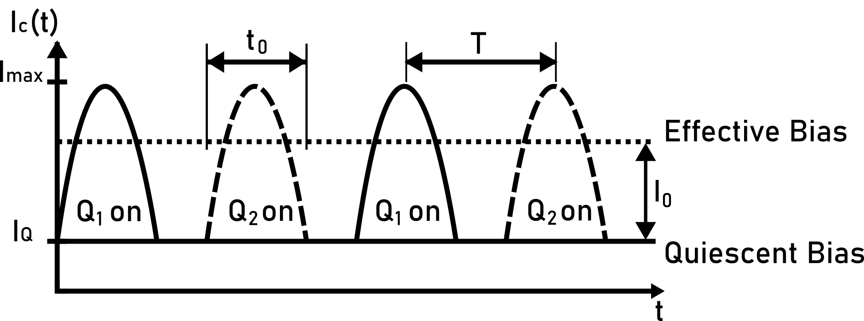
Push-pull Frequency Multipliers
Input is rectified to produce pulsed waveform
We can get a 4th harmonic
But there is an additional DC current
Affects biasing and gain
Causes extreme gain sensitivity to power
Fourier Series
Conventional Multiplier

Slide 6
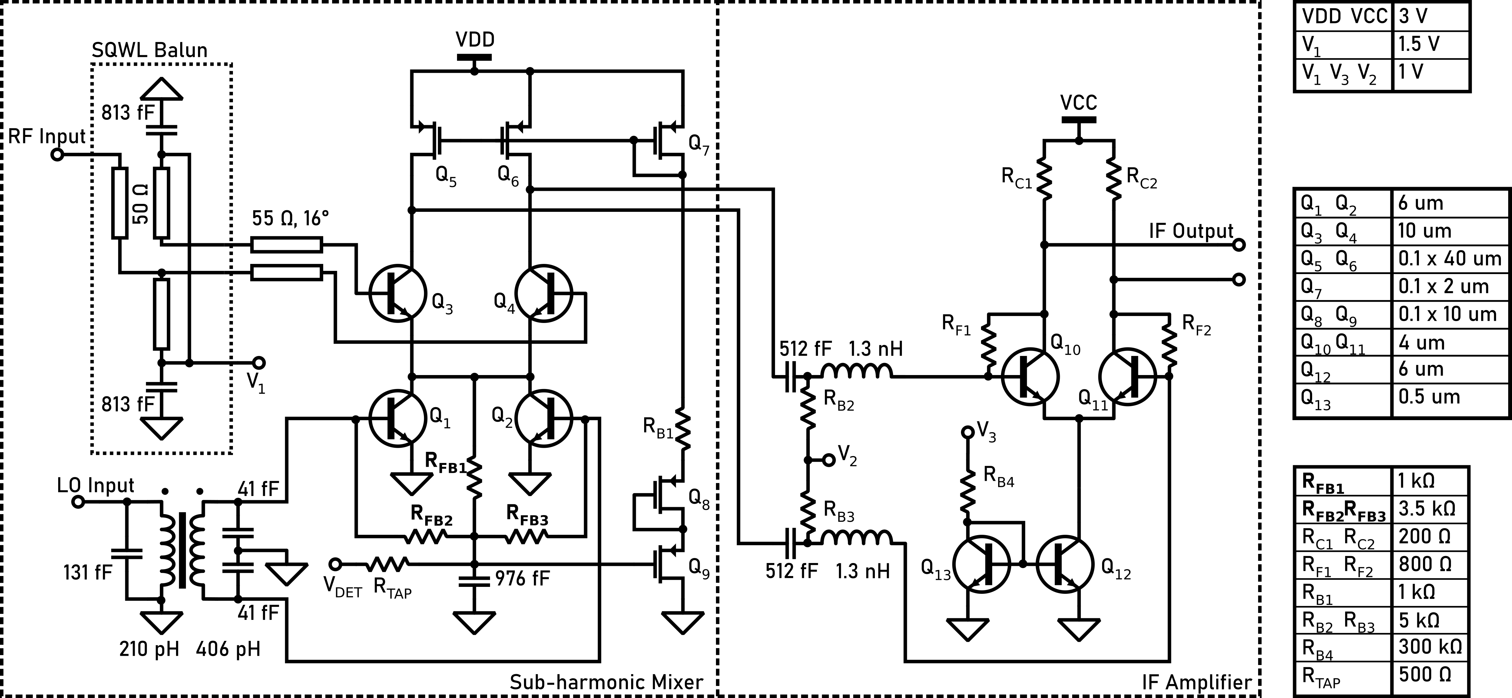
Proposed Downconverter
Active Load
Mixer
X4 Frequency
Multiplier

Slide 7
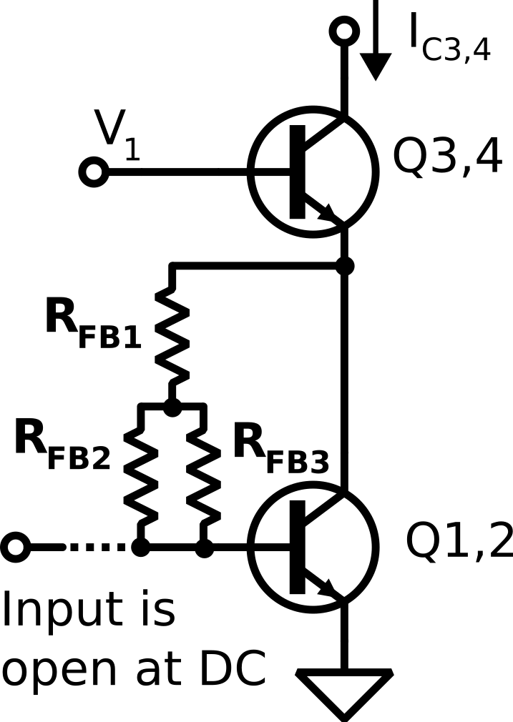
Feedback Bias Analysis
Equivalent DC Model

Slide 8
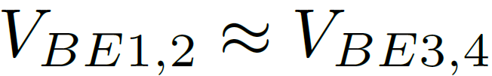
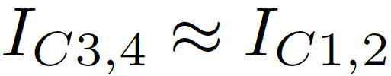
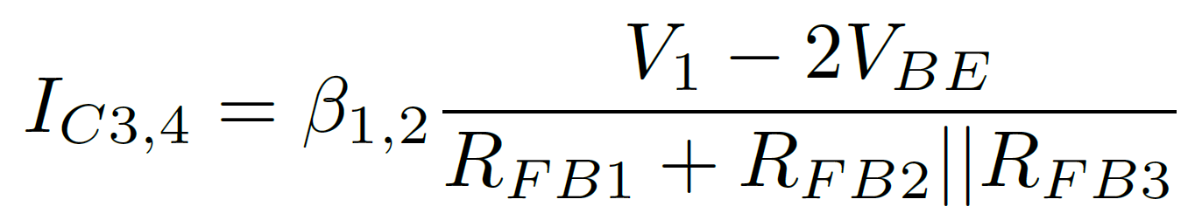
Proposed Design: Feedback Bias
Parallel transistors shorted at DC: treat as one
Simplifying assumptions:
Feedback Bias has stable bias point:
Current change suppressed by negative feedback on V_{BE}
Equivalent DC Model

Slide 9
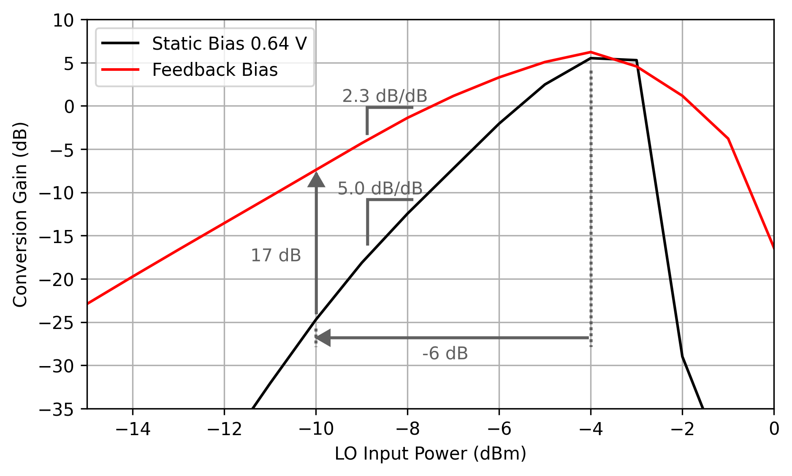
Simulated Effect of Static Biasing
With -6 dB LO backoff from peak gain
17 dB more gain than static biased version
Obtain higher performance at back-off and less sensitive gain

Slide 10
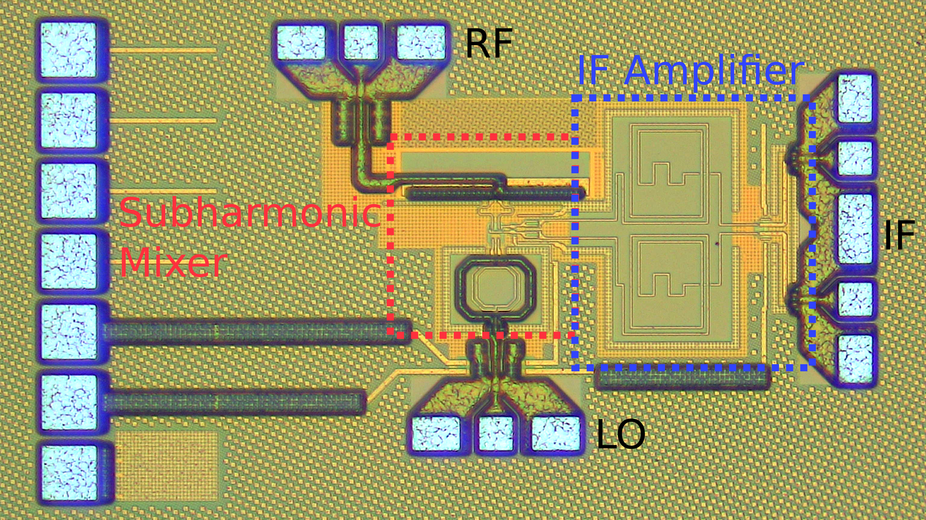
Layout
Global Foundries 9HP+
90-nm SiGe BiCMOS
Core: 0.56 mm x 0.35 mm

Slide 11
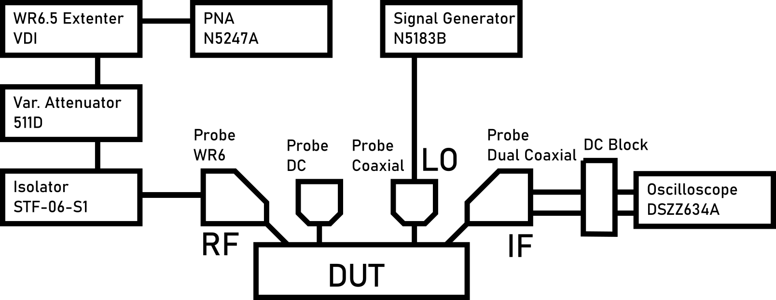
Measurement
Results calibrated with reference power meter (scalar measurement)
Differential mismatch compensated with time delay in oscilloscope

Slide 12
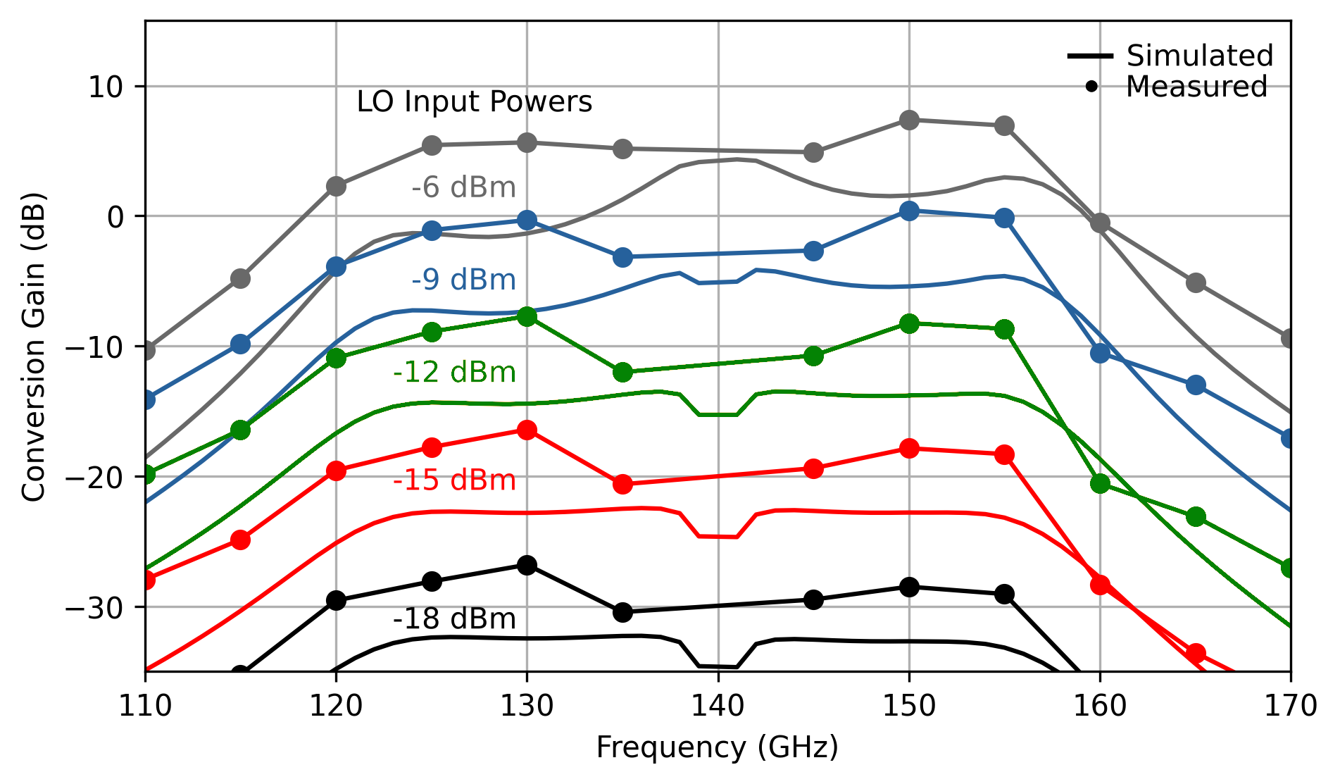
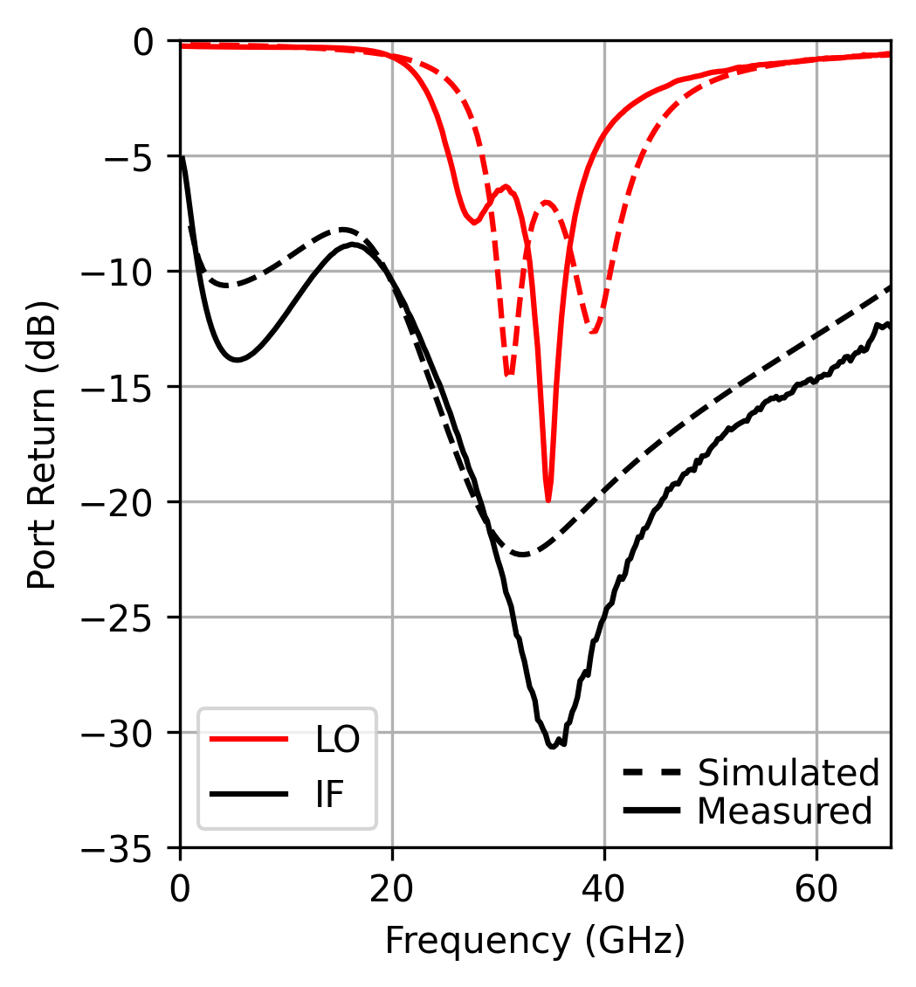
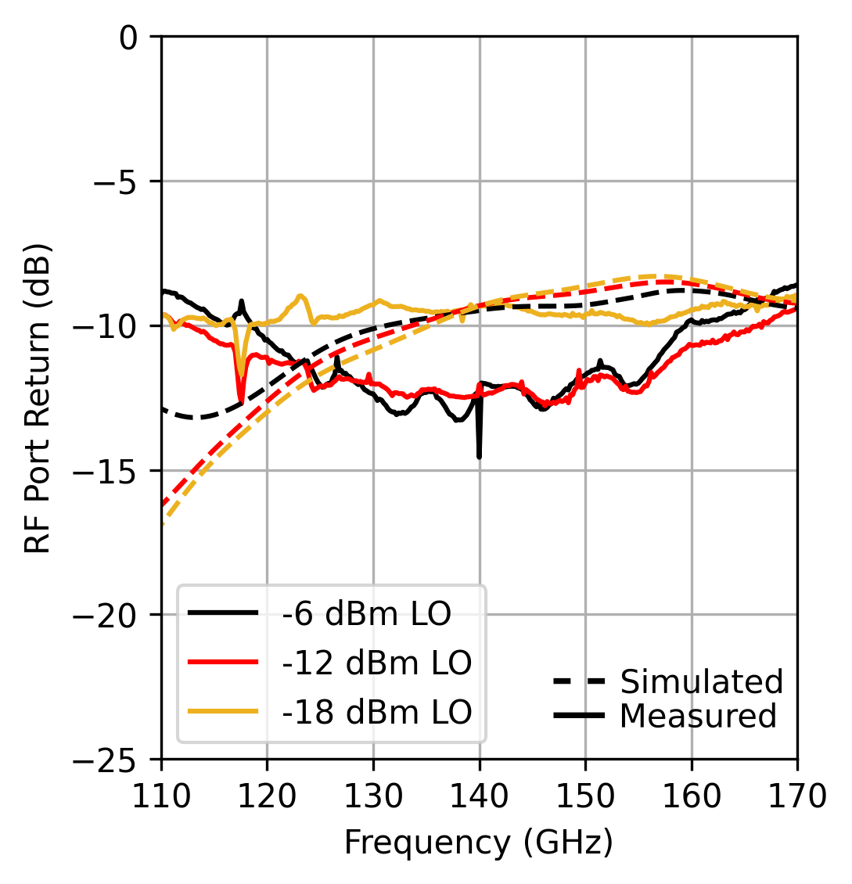
Conversion Gain Over Frequency
Reliable control of conversion gain over a wide LO power range
LO port frequency shift led to better match at target LO frequency

Slide 13
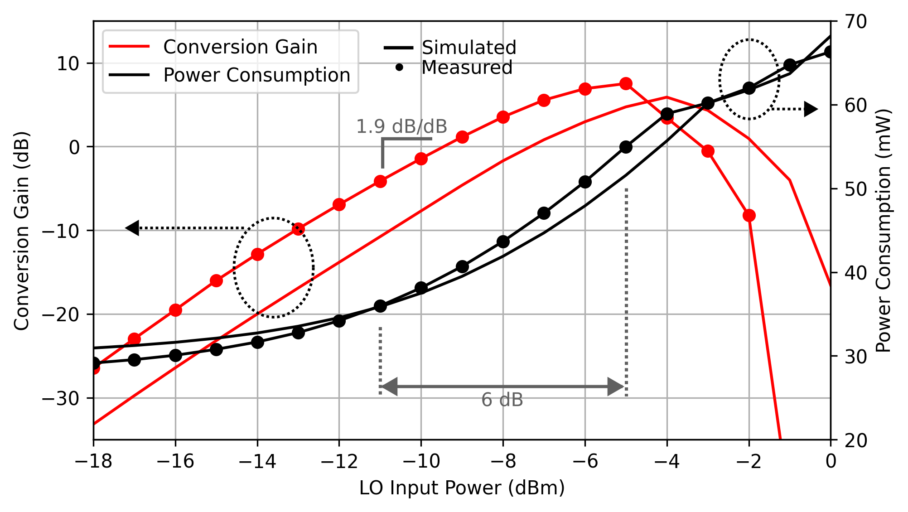
Power Consumption Tradeoff
Back off LO power from -5 dBm to -11 dBm
Trade 11.7 dB of gain to save 35% power
155 GHz RF with 140 GHz LO

Slide 14
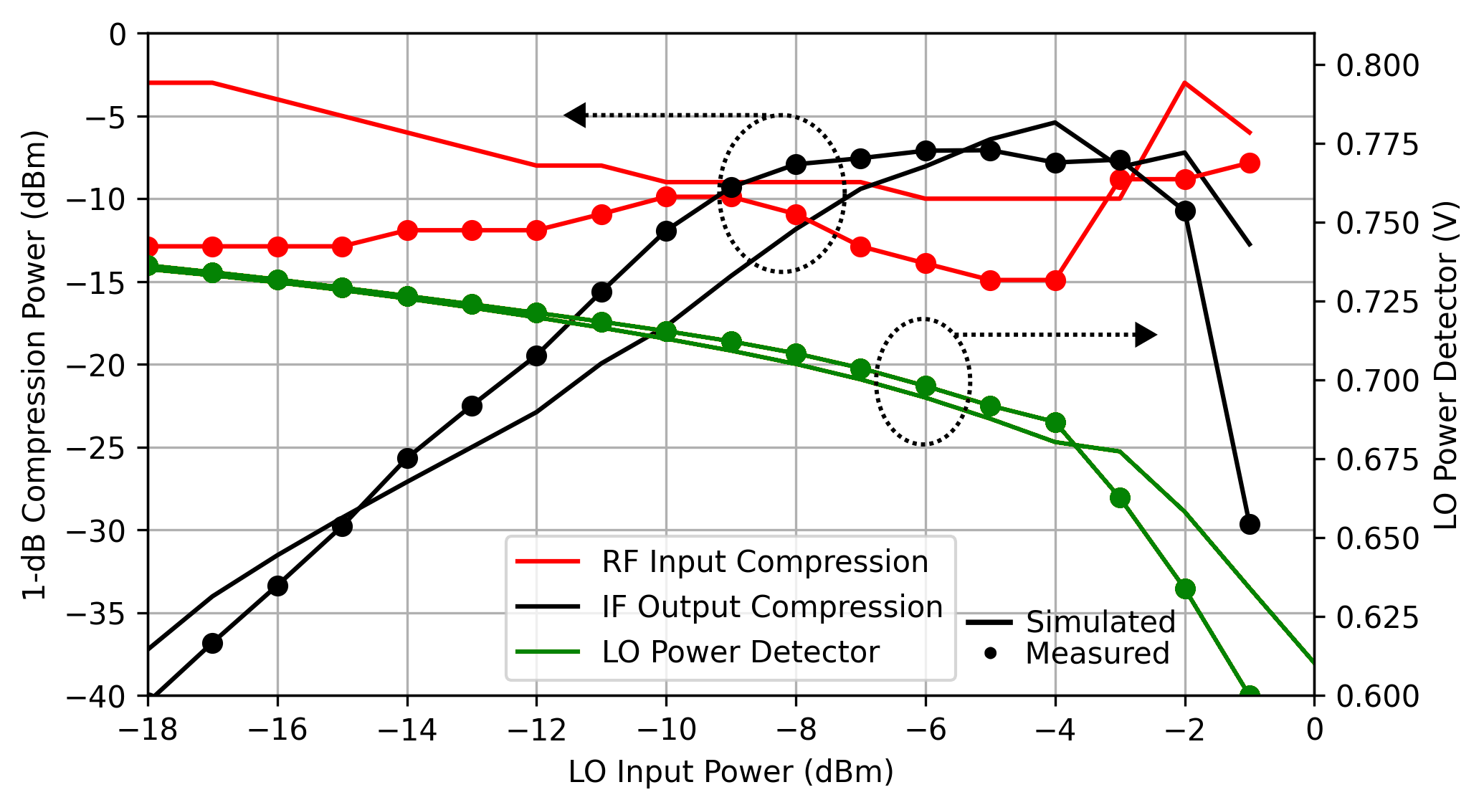
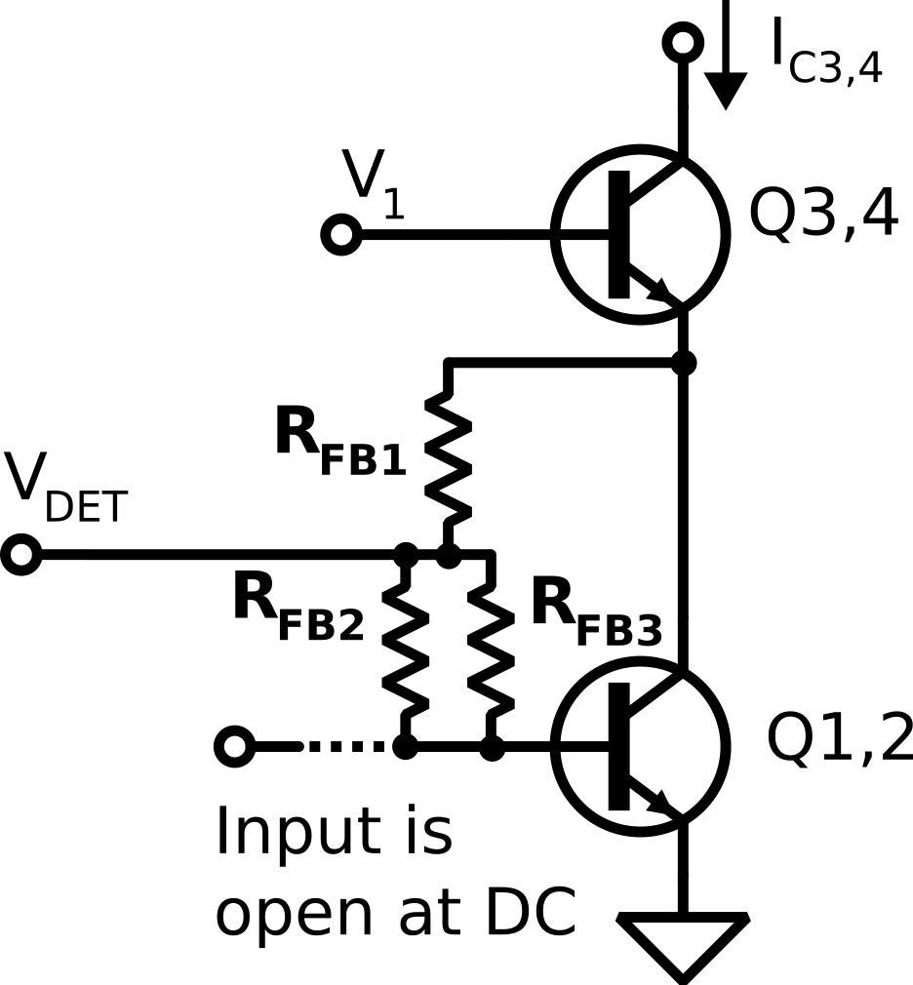
Compression and Power Detector
Input compression is insensitive to LO power variation
Feedback bias circuit can be used for LO power detection

Slide 15
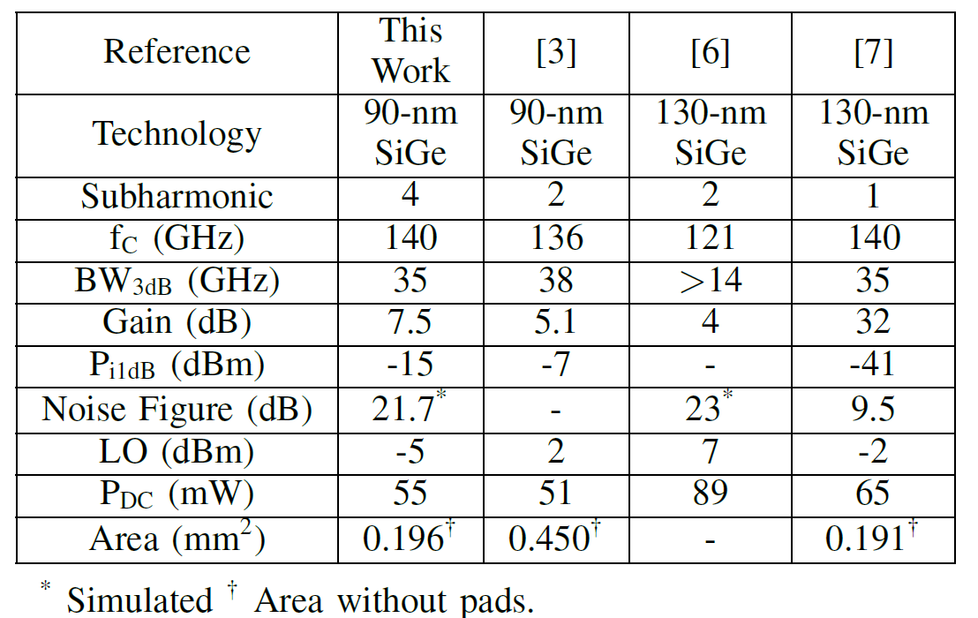
Conclusion
A fourth subharmonic D-band downconverter is implemented with bias feedback
Demonstrates reliable LO power backoff to save power
Achieves a high multiplication factor without sacrificing additional area, power consumption, or LO power requirement

Slide 16


Acknowledgements
This work was supported by the Semiconductor Research Corporation (SRC) under the JUMP program, Cognisense
The authors appreciate the support of GlobalFoundries for access to the 9HP+ process.

Slide 17
Comparison References
[3] A. Moradinia, Y. A. Mensah, B. L. Ringel, and J. D. Cressler, “A 117–155-GHz SiGe HBT D-Band Subharmonic Mixer Utilizing a Novel 180° Hybrid Coupler,” IEEE Microwave and Wireless Technology Letters, vol. 33, no. 6, pp. 731–734
[6] K. Schmalz, W. Winkler, J. Borngr¨aber, W. Debski, B. Heinemann, and J. C. Scheytt, “A Subharmonic Receiver in SiGe Technology for 122 GHz Sensor Applications,” IEEE Journal of Solid-State Circuits, vol. 45, no. 9, pp. 1644–1656,
[7] T. Maiwald, J. Potschka, K. Kolb, M. Dietz, A. Hagelauer, A. Visweswaran, and R.Weigel, “A Broadband Zero-IF Down-Conversion Mixer in 130 nm SiGe BiCMOS for Beyond 5G Communication Systems in D-Band,” IEEE Transactions on Circuits and Systems II: Express Briefs, vol. 68, no. 7, pp. 2277–2281

